Slide 1
Team 1
Challenge descritpion

Slide 2
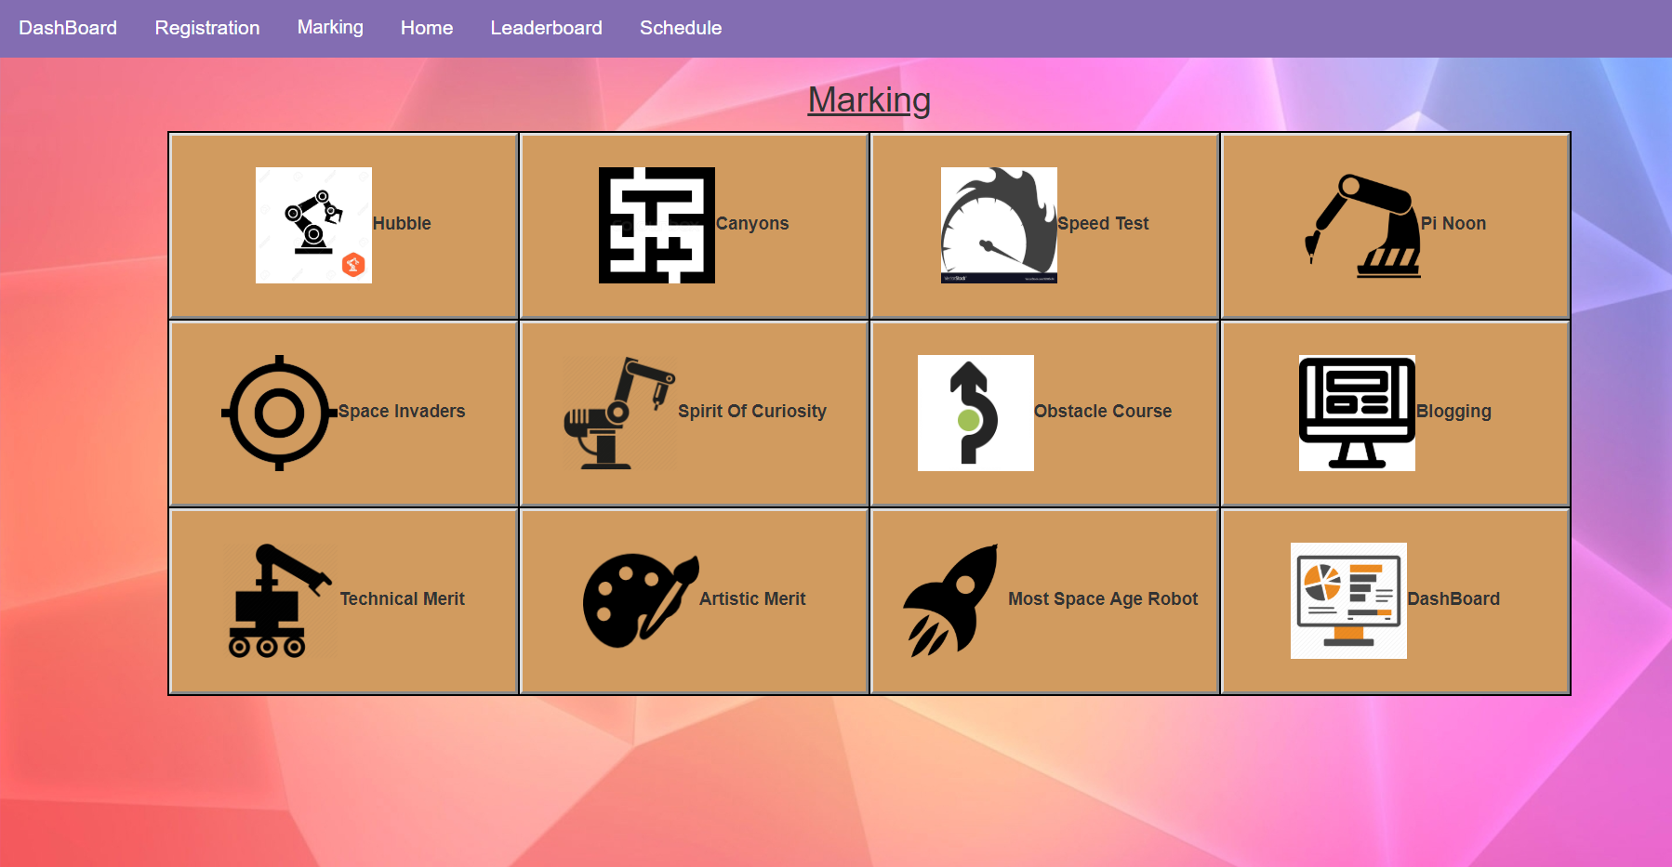
Challenge selection screen

Slide 3
Challenge: Canyons of mars
Goal- Complete the course the quick as possible in three times
Category - Autonomous
Limit Time 7 minutes
Challenge is not completed until all the participants finish the challenge.
The shortest time will be taken of the three rounds to rank over all the participants
Extra Points
50 additional points for each completed run.
20 additional points for each run completed without touching the walls.
15 points for each of the 7 zones entered. These zones correspond to areas covering each turn and will be marked out on the course walls for reference.
Penalties - Is allowed to rescue the robot and place back in the course one per run, and additional rescue is permitted with a 15 seconds penalty, a third rescue is not permitted, instead the run must be abandoned.

Slide 4
Canyons of Mars
Team:
NAME OF TEAM
ROUND 1
ROUND 2
ROUND 3
Lap time:
TIME ROUND 1
Walls Touched:
RADIO BUTTONS (YES AND NO)
Extra Zones:
RADIO BUTTONS (FROM 1 TO 7)
PENALTIES
Number of Rescues
RADIO BUTTONS (1 AND 2)

Slide 5
Challenge : Apollo 13 / Obstacle Course
Goal – overcome obstacles and return to the designed point
Failure is not an option
Category – Remote-Controlled.
Three opportunities, 7 minutes each one
Challenge is not completed until all the participants finish the challenge.
The shortest time will be taken of the three rounds to rank over all the participants
Extra Points
50 points will be awarded for each successfully completed obstacle on your fastest run.
30 additional points will be awarded for each run in which you negotiate all obstacles successfully. (i.e. a ‘clean’ drive with no rescues and no skipped obstacles).
Penalties
For each skipped obstacle, the time increases by 20 seconds
Rescues of the robot are penalty free but a expense of time.

Slide 6
Apollo 13 / Obstacle Course
Team:
NAME OF TEAM
ROUND 1
ROUND 2
ROUND 3
Lap time:
TIME ROUND 2
Obstacles Completed
RADIO BUTTONS (NUMBER OF OBSTACLES)
PENALTIES
Obstacles Skipped
RADIO BUTTONS (NUMBER OF OBSTACLES)

Slide 7
Challenge : Space Invaders
Goal – knock down as many targets as possible
Category – Remote-Controlled.
Three attempts with 5 projectiles each or total time of 5 minutes
There will be a ‘boundary line’ beyond which robots are not permitted to go
Two possible methods:
Five balls that are provided by organizers and will be waiting in set position
Robot has a mechanism capable of firing 5 soft projectiles
REGULAR POINTS
20 points for each target knocked down
If there is same score between two teams, fastest team takes higher ranking
EXTRA POINTS
30 points if every ball in the round knocks down at least one target
75 points for any team using method 2
PENALTIES
If robot crosses the boundary line shot will not be counted

Slide 8
Space Invaders
Team:
NAME OF TEAM
ROUND 1
ROUND 2
ROUND 3
Faul
First shot:
RADIO BUTTONS (FROM 1 TO 5)
Second shot:
RADIO BUTTONS (FROM 1 TO 5)
Third shot:
RADIO BUTTONS (FROM 1 TO 5)
Fourth shot:
RADIO BUTTONS (FROM 1 TO 5)
Fifth shot:
RADIO BUTTONS (FROM 1 TO 5)
Total time:
TIME (Field only exists in round 3)

Slide 9
Challenge: Blast Off: the Straight-ish Line Speed Test
Aim: To drive from one end of the course to the other as fast as possible.
Control Method : Autonomous
Limit Time: 5 minutes
Laser-timed for accuracy.
Robot must cross the finish line for the time to be recorded.
3 rounds
Ranked according the total time of 3 rounds
Only those robots that have completed three runs will be eligible for ranking.
After the completion of the 3 rounds points will be awarded to the top ranked robots:
1st: 40 points, 2nd: 32 points, 3rd : 25 points, 4th : 18 points, 5th : 15 points, 6th : 12 points, 7th : 10 points, 8th : 8 points, 9th : 6 points, 10th : 4 points, 11th : 2 points, 12th : 1 point
Extra Points
100 additional points for each completed run.
45 additional points will be awarded for each run where the robot does not touch the sides of the course.
70 additional points will be awarded to the robot with the fastest individual run.
Penalties
Each touch of the walls incurs a 10 second penalty up to a maximum of 30 seconds.
Robots scraping along the wall(s) will be penalised to the maximum of 30 seconds.
It is permitted to rescue the robot and place it back on the course at the place where things went wrong once per run without penalty, but the clock will not be stopped.
An additional rescue is permitted, incurring a 15 second penalty.
A third rescue is not permitted; instead the run must be abandoned.
Abandoned or non-completed runs will be penalised by 60 seconds.

Slide 10
Blast Off: the Straight-ish Line Speed Test
Team:
NAME OF TEAM
ROUND 1
ROUND 2
ROUND 3
Lap time:
TIME ROUND 1
0: +45 points
1: -10 sec
2: -20 sec
3+ or scraping -30 sec
Completed Run?
Check box (extra 100 points)
PENALTIES:
Touch walls or
scraping:
Radio Button 0,1,2,3+ or scraping
2nd rescue:
Check box (-15 seconds)
Abandoned or non-completed:
Check box (-60 seconds)

Slide 11
Challenge: Spirit of Curiosity
Goal: Remote control robots to collect rock samples from one corner of an arena with uneven terrain to its opposite corner.
Category: Remote-Controlled
Time Limit: 5 minutes (A single attempt of the challenge is permitted within the 5 minute limit).
Rules:
There will be multiple routes to the sample site. It is up to the roboteer which route they take to and from the site.
Both loading and unloading of the sample is expected to be a manual pick-up-and-place by member(s) of the roboteers’ team or a volunteer.
Points:
45 points will be awarded per sample collected.
40 bonus points will be awarded for any team collecting more than 5 samples.

Slide 12
Spirit of Curiosity
Team:
NAME OF TEAM
ROUND 1
Time:
5 minutes
The number of rock sample:
Input a number (The points will be calculate automatically according to the number)

Slide 13
Challenge :The Hubble Telescope Nebula
Goal - To visit each of the four target areas within the time limit.
Category - Autonomous
Time Limit - 7 Minutes (for all 3 rounds)
Three run attempts are permitted,not compulsory but encouraged,
Two methods of operation
Ranks are calculated after all the players finish.
The shortest run of the three runs will be used to rank.
The robot with the shortest time will take first place.
 | Method 1 | Method 2
Order of zones | Red, Blue, Yellow, Green. | Any order
each colour zone entered | 35 | 30
All zones in correct order/ all zones entered | 30 | 25

Slide 14
The Hubble Telescope Nebula Penalties :
One rescue per run without penalty but the clock will not be stopped.
A second rescue is permitted, incurring a 15 second penalty.
A third rescue is permitted, incurring a 15 second penalty.
A fourth rescue is not permitted, instead the run must be abandoned.
Abandoned or non-completed runs will not count towards the shortest run time, however any points accumulated during the incomplete run will count towards the overall score.

Slide 15
The Hubble Telescope Nebula
Team:
NAME OF TEAM
Method:
Radio Button: Method 1,Method 2
ROUND 1
ROUND 2
ROUND 3
Zone visited in Correct order(Method 1), Zones Visited(Method 2)
Red :
Radio Button Yes, No
Blue :
Radio Button Yes, No
Yellow :
Radio Button Yes, No
Green :
Radio Button Yes, No
Lap Time:
Text Field
PENALTIES:
Rescue Count:
Radio Button 0,1,2,3,4 or more

Slide 16
PI Noon
40 points will be awarded as a result of a ‘bye’ or ‘no show’.
winner of each duel will be awarded 50 points, and will gain entry into the next round
100 bonus points will be awarded to First place.
75 bonus points will be awarded to Second place
50 bonus points will be awarded to Third place
25 bonus points will be awarded to Fourth place.

Slide 17
PI NOON: THE RIGHT STUFF
Team 1:
NAME OF TEAM
Team 2:
NAME OF TEAM
Scroll down menu: i.e. Round 1/Semi-final /Grand-final
Select round:
Both teams arrived:
RADIO BUTTONS (YES, Team 1/2 no show)
Winner
RADIO BUTTONS (Team1 or Team 2)
Method of winning:
RADIO BUTTONS (...)

